Slide 1


Analyzing Industrial Emissions Using USEPA Data

Slide 2
Table of Content
Problem Statement
Business Understanding
Introduction
Emission Dataset
Data Cleaning
Heat Map
Bubble Chart
Business Insights
Bar Chart-1
Bar Chart-2
Business Insights
Line Graph-1
Line Graph-2
Business Insights

Slide 3
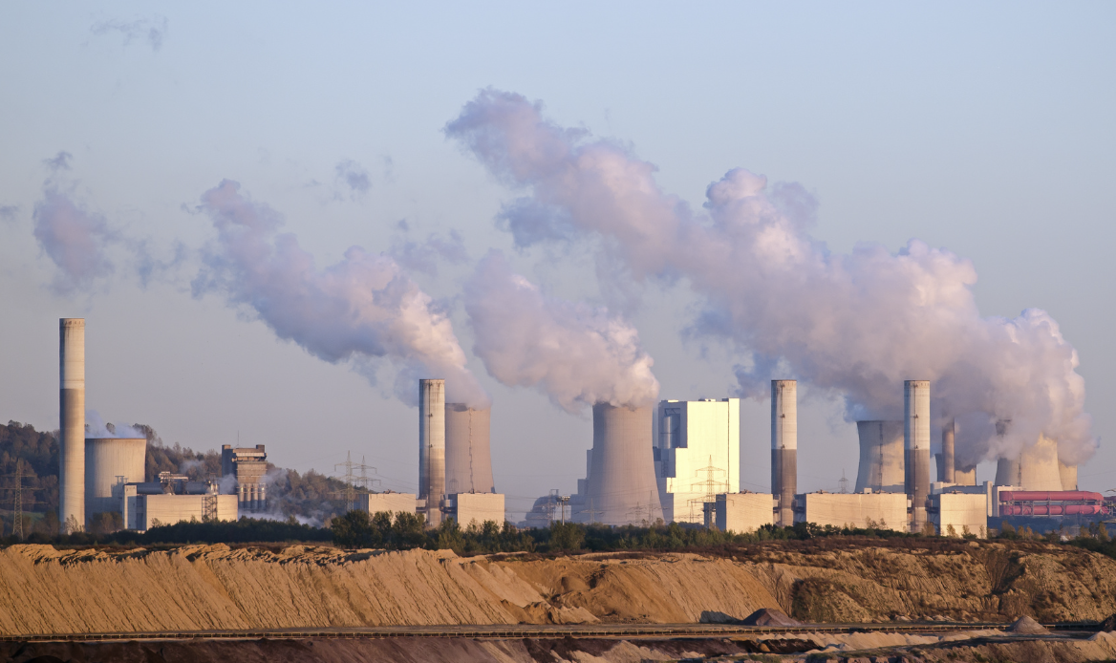
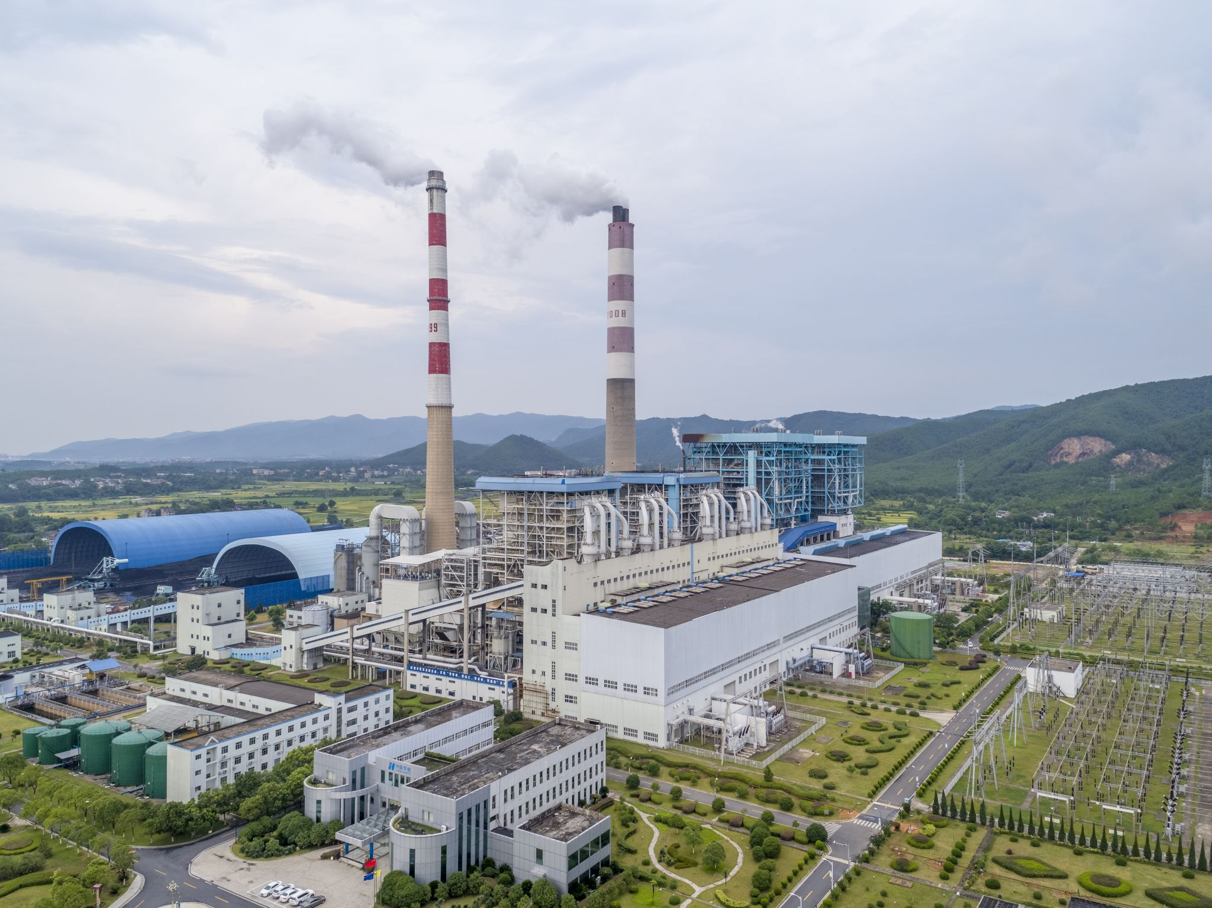




Problem Statement
The Impact of industrial greenhouse gas emissions on climate change, with a focus on environmental and health consequences, and how emissions vary across different industries and regions. What trends can be analyzed to guide effective reduction strategies ?

Slide 4

Business Understanding
Who – Industrial Sectors, Chief Sustainability Officer , National and local governments , Non-Government Organization(NGOs), Climate and Data scientists , Supply Chain Managers
Why – Variations in emission standards, industrial techniques, energy sources influence the environmental effect. Lack of investment in energy efficiency and environmentally friendly technologies raises pollution levels and sustainable developmental problems.
Purpose – Improve environmental safety by spotting patterns in high emission industries , regions and areas that require immediate attention. These trends helps to promote environmentally friendly and industrially expanding sustainable methods.

Slide 5

Introduction
Climate change due to carbon emissions is one of the major challenging problems to be tackled. This project analyzes significant variations in heat input capacity and emission types in several US industrial sectors.
This analysis is based on data from the U.S. Environmental Protection Agency (EPA) and looks at more than 70 industrial sectors for the period of 2010 to 2022 over 50 states and cities.
The goal is to identify the primary trends in emissions over certain industries, pinpoint regions of concern, and suggest feasible options for minimizing emissions while promoting environmentally friendly growth in industries.
It helps to make decisions and renewable energy solutions to create a more policies and focused interventions.
Emission Types - Methane (CH4), Carbon dioxide (CO2),Co2-Biogenic and Nitrous oxide (N2O) .

Slide 6
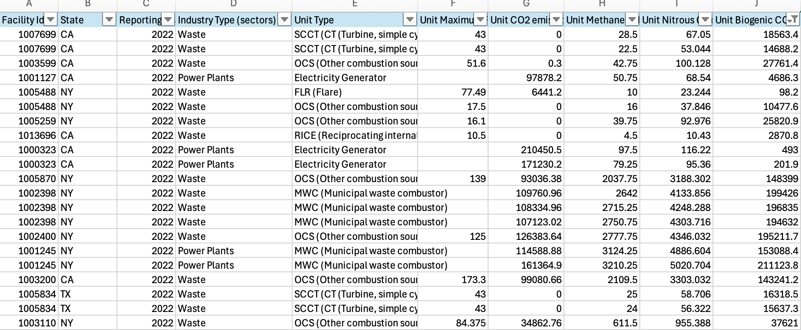
Emission Dataset

Slide 7
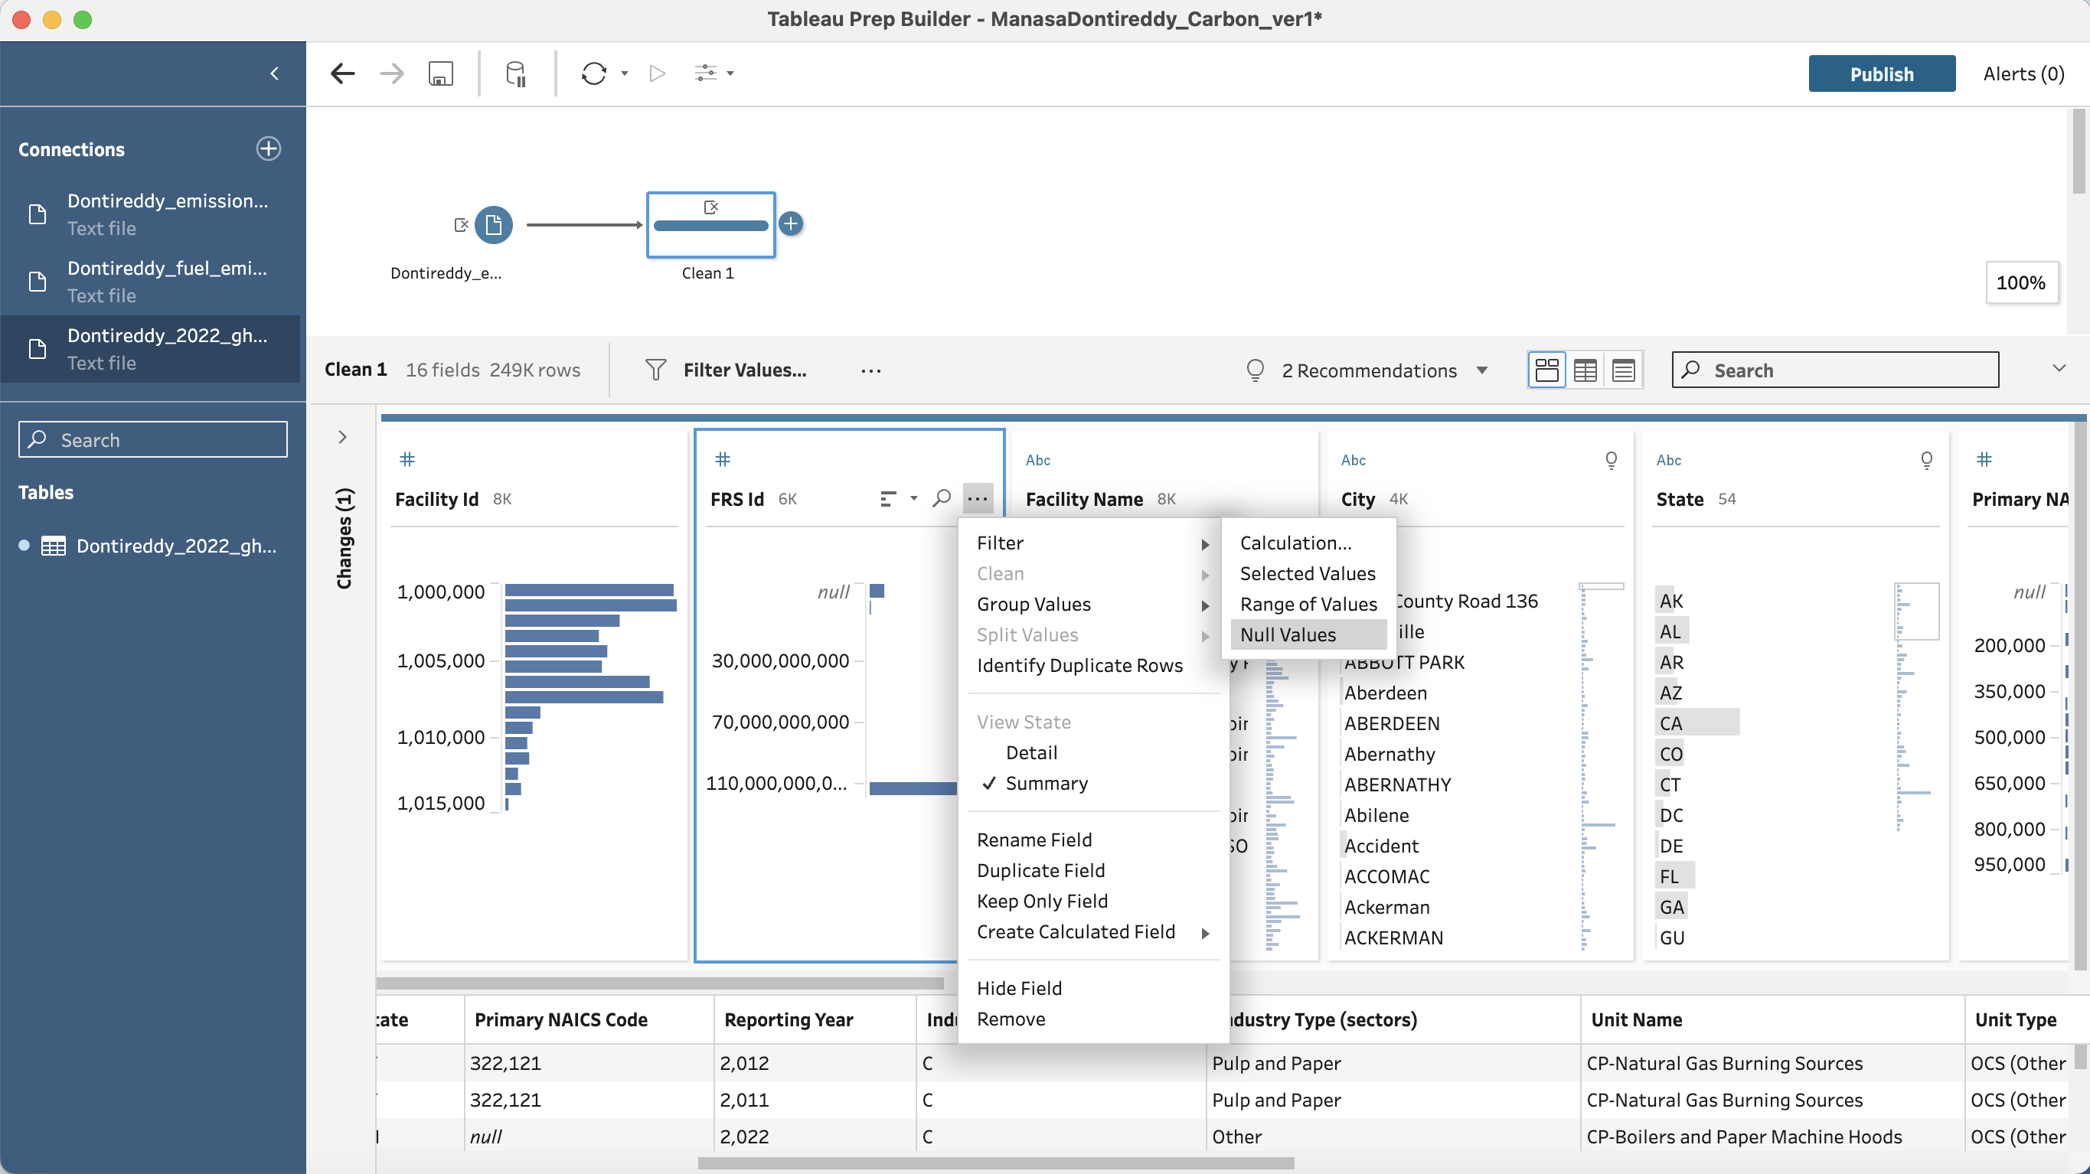
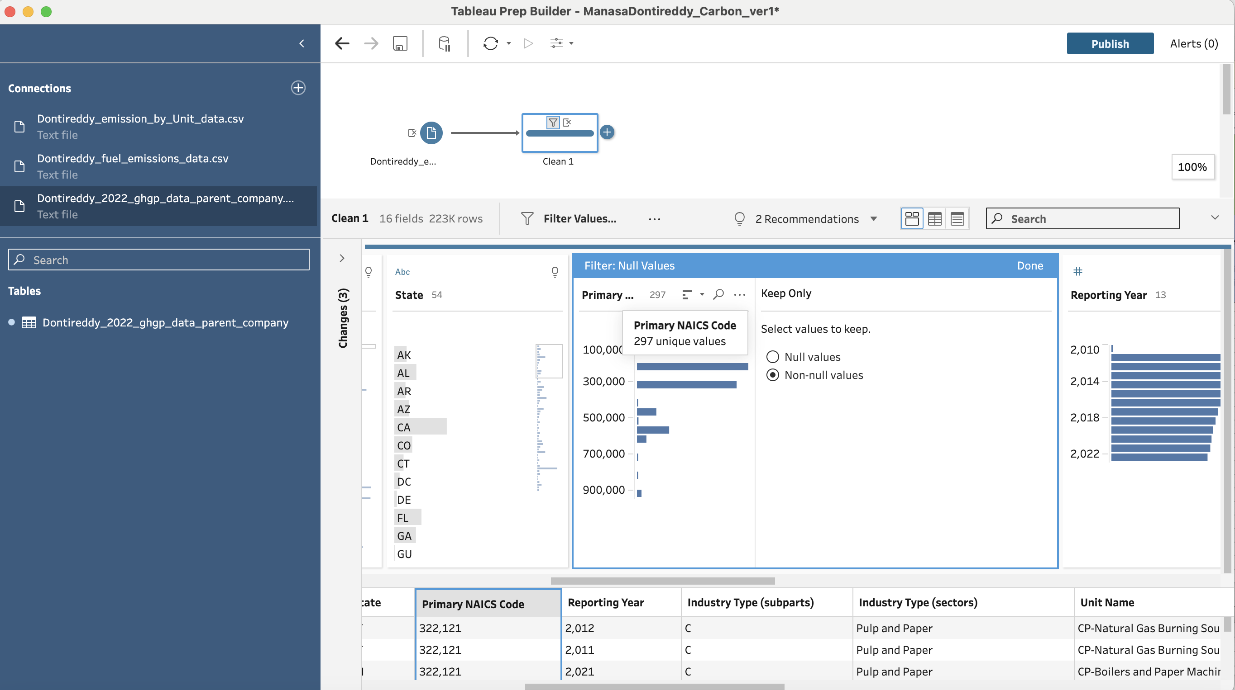
DATA CLEANING IN TABLEAU Removing NULLS: FRS ID/Primary NAICS code should not be null. so, removing all NULL values.
After NULL
Before NULL

Slide 8
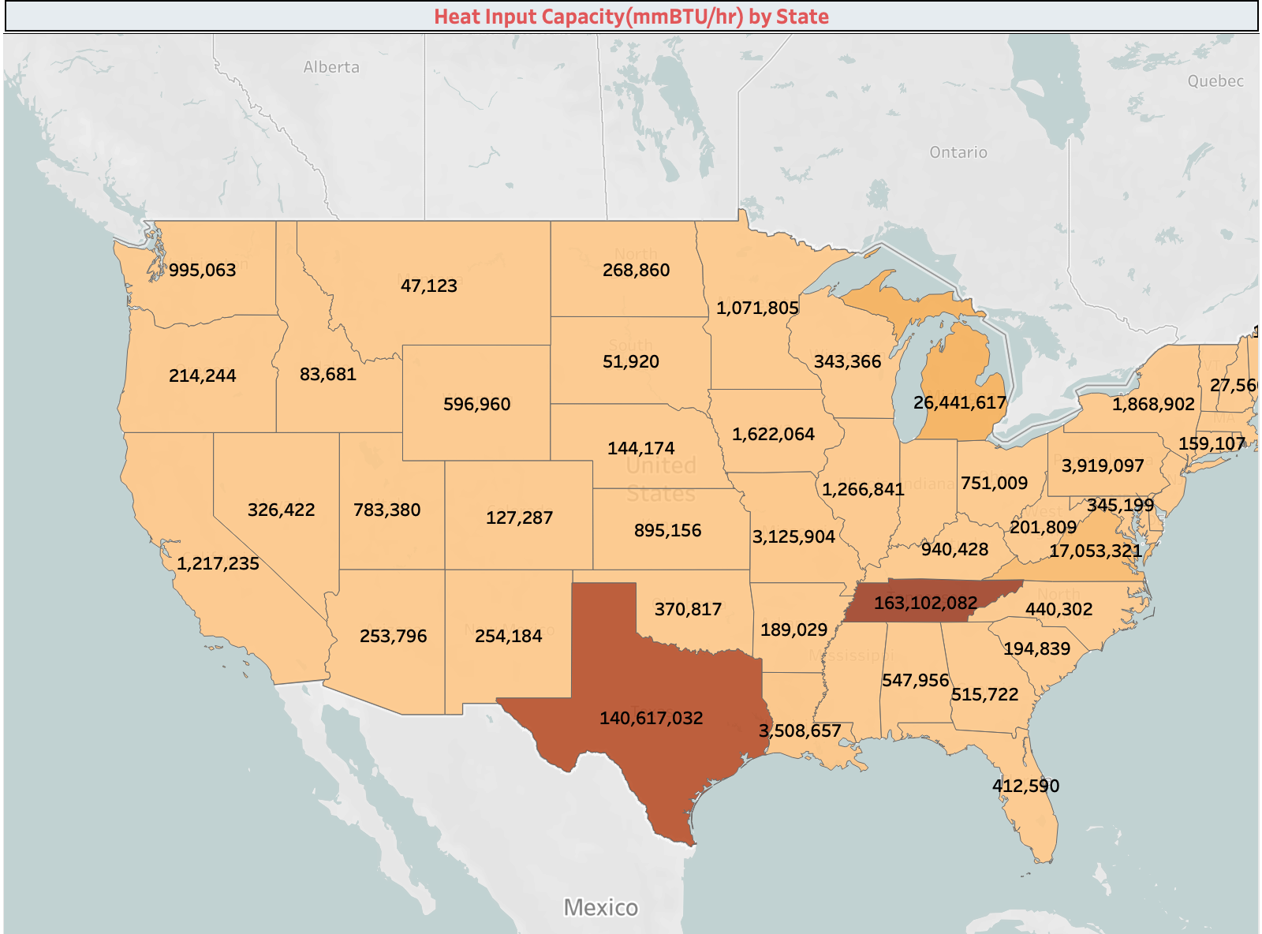
DATA VISUALIZATION – TABLEAU Heat Input Capacity by State (2010-2022)
This graphic is a map chart that shows the total maximum rated heat capacity with time for each state.
Texas has the highest heat capacity with 330,934 mmBTu/hr. Also, TN stands second highest 167,617 mmBTu/hr over decade.
Also, MI , MN ,UT ,VA ,WA ,WY and NY has the highest heat capacity over first 2 years and then seen decreasing trend.
The state PR and OH has very low heat capacity rate over the last decade when compared to other states.

Slide 9
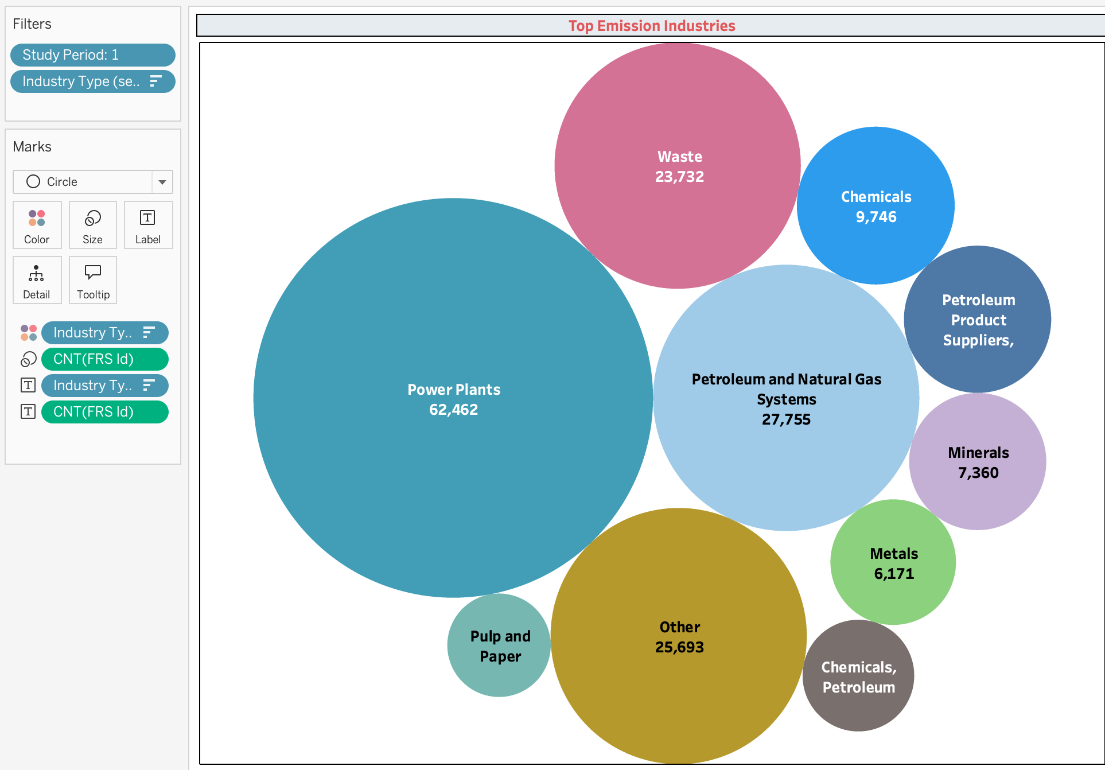
Top Emission Industries
This graphic is a bubble chart that shows the top emission industries over time
Power plants seems to have the highest emitted rate with 64,462 followed by Petroleum and Natural Gas with 27,755.
Also, Waste , chemicals and minerals came the next highest when compared to other sectors.

Slide 10
Business Insights
Changes in Heat Input Capacity by State: The heat input capacity varies significantly across various states. States with high maximum rated heat input capacity values year after year include Texas (TX), California (CA), and Louisiana (LA).
To lessen the environmental impact of high-heat capacity industries, Chief Sustainability Officer ,firms and governments may need to concentrate on energy-efficient technologies and stronger restrictions making sure they adhere to carbon reduction goals .
Industry-Specific Trends: Petroleum & Natural Gas , Chemicals, Power plants, and CO2 injection are examples of high heat/emitted industries that have continuously had significant heat values over time. Metals and waste has lower heat values which means miners and metal processing operations use less energy.
Years-to-Year Change in Heat Capacity: Several states exhibit notable variations in heat input capacity from one reporting year to the next, which may be a sign of adjustments to energy legislation or industrial activity levels.
This may indicate that industrial establishments have made investments in energy efficiency upgrades, scaled back activities, or expanded, all of which influence their yearly energy needs and emissions. National and local governments have the power to establish laws and rules to lower heat emissions.

Slide 11
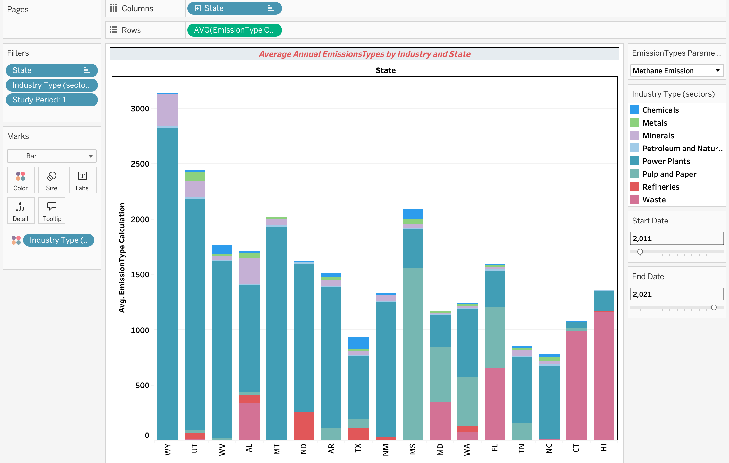
Average Annual Emission Type-MH4 by Industry and State
This graphic is a Bar chart that shows the total average emission type methane with time for each industry sector and state. The y-axis shows methane emission, and the x-axis shows years from 2010 to 2011 .
Petroleum and Natural Gas System, Chemicals, Power Plants, Waste and Minerals) and 50 states with a total average emission from 0 to 3k for each corresponding year
On other hand , Minerals and Metals seems to emit least average over the decade and is constant with average of 700 and 150.

Slide 12
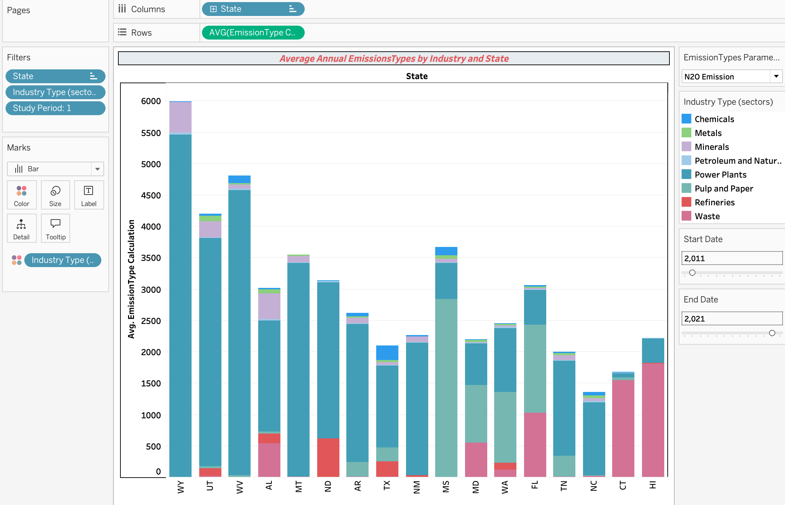
Average Annual Emission Type-N20 by Industry and State
This graphic is a Bar chart that shows the total average emission type N20 emission with time for each industry sector and state. The y-axis shows N20 emission, and the x-axis shows years from 2010 to 2011 .
Power Plants, Waste, Pulp and Paper are highest N20 emissions with around 5000-6000 for each corresponding year
On other hand , Minerals and Metals seems to emit least average over the decade and is constant with average of 700 and 150.

Slide 13
Business Insights
Industry Specific Trends: The key industries that contribute to emissions help organizations and lawmakers prioritize their efforts on reducing emissions. The Pulp and Paper industry consistently ranked highest among others from 2010 to 2023, exhibiting minor fluctuations for the CO2 biogenic emissions.
This suggest that Power plants need to increase in efficiency in energy use. Industrial sectors must implement reduction of carbon efforts based on insights from data.
Overall Analysis: CO2 is the primary contributor to emissions, with an average of around 600,000 units. This significantly outweighs the other emissions like CO2 biogenic, N20, and methane.
Climate and Data Scientist need to lessen the effects of climate change and cut back on emissions of carbon dioxide.
Each emission Type Trends: power plants have major effect on each emission type – for Co2 Emission averaging about 310,000 units each year. Methane Emission and N20 Emission: Power plants produced most emission from 2015 to 2022 . Co2-Biogenic emission: From 2010 to 2023, power averaging about 20,000 units each year.
Targeted measures are needed in this industry to reduce its high biogenic emissions.

Slide 14
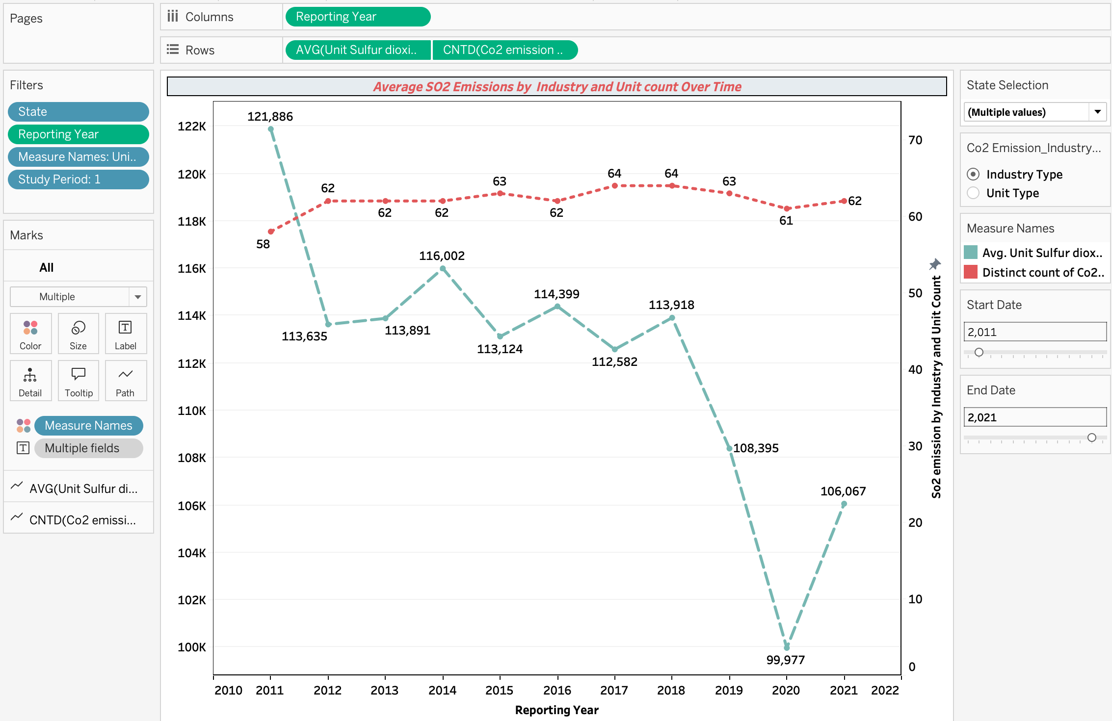
SO2 Emissions by Total Industries Type Over Time
This graphic is a Line chart that shows the total average annual unit SO2 emissions (not biogenic) for each year overlaid with the distinct count for industries that contribute to those emission types with time for each industry sector and state
The So2 emission has the highest average on 2011 with value of 123,647 and then shows the decreasing trend until 2020 and then started to rise to the next continuous years.
Also, the industry count tends to make ups and downs throughout the years which is stable between 62,63 and 64

Slide 15
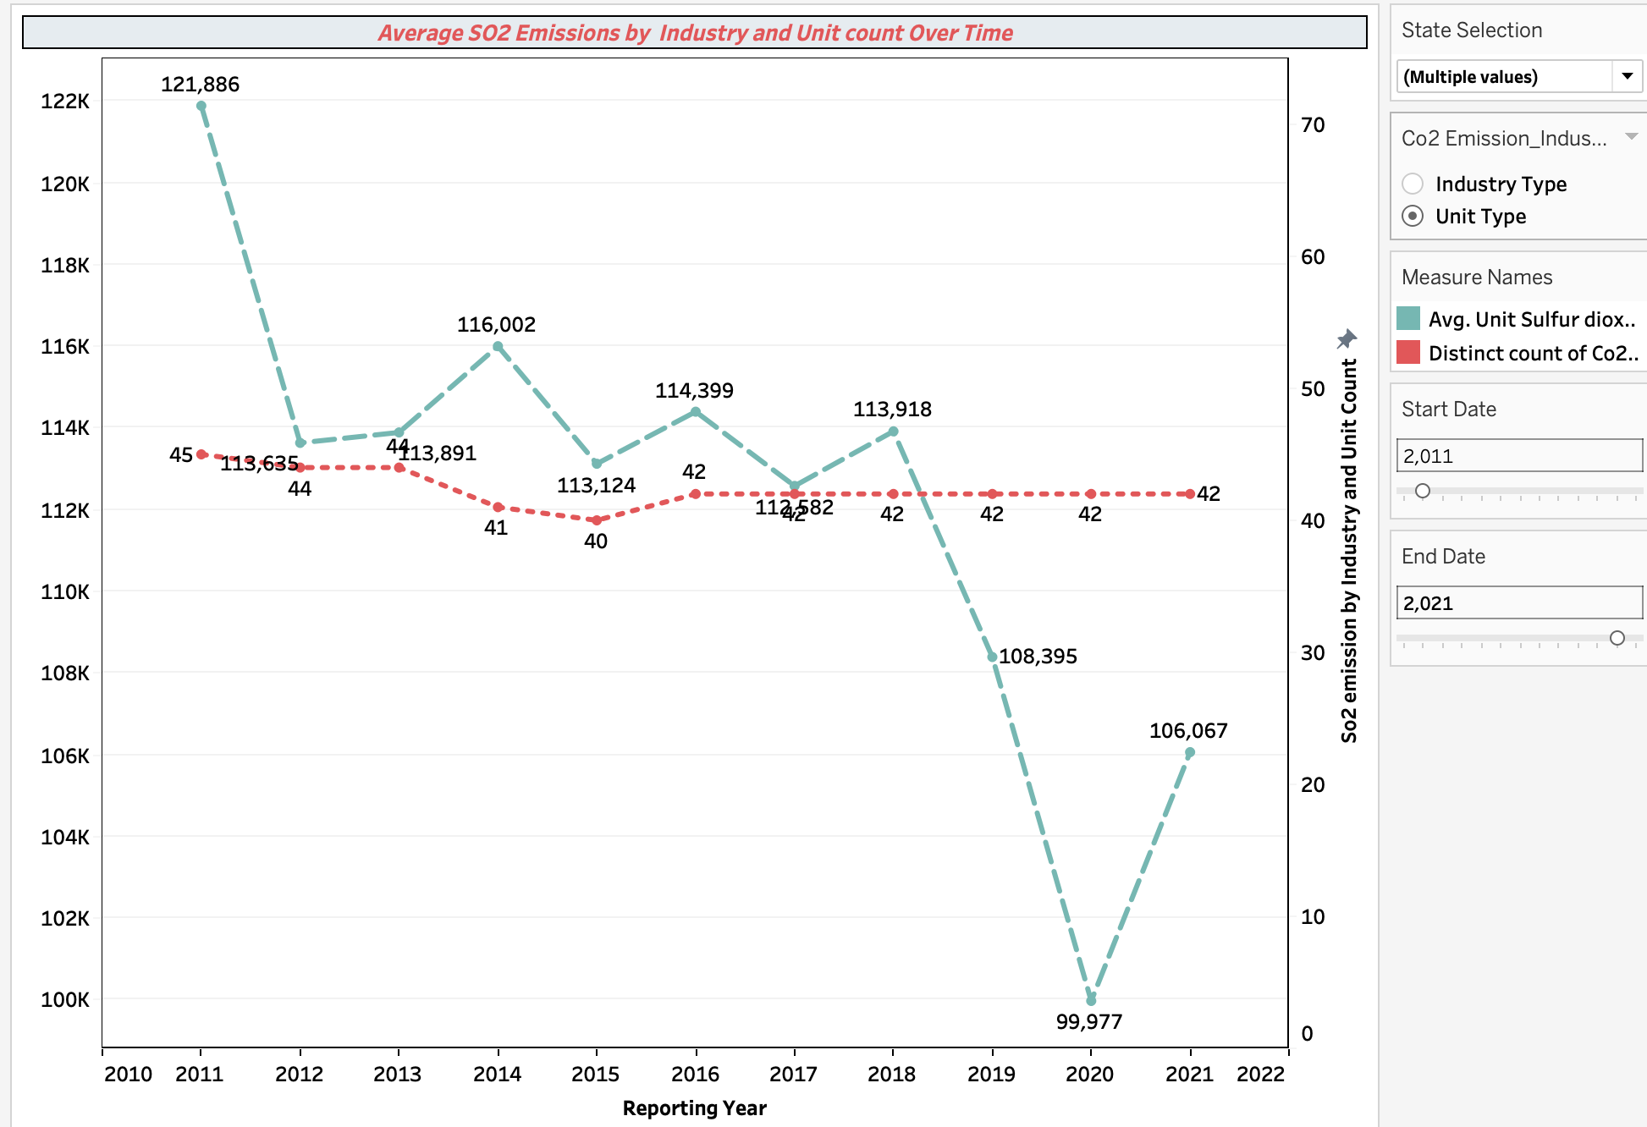
SO2 Emissions by Total Unit Type Over Time
This graphic is a Line chart that shows the total average annual unit SO2 emissions (not biogenic) for each year overlaid with the distinct count for unit type that contribute to those emission types with time for each unit and state
The So2 emission has the highest average on 2011 with value of 123,647 and then shows the decreasing trend until 2020 and then started to rise to the next continuous years.
Also, the unit type count tends to be constant throughout the years which is 42.

Slide 16
Business Insights
The graph suggests that although the total number of industries contributing to CO2 emissions has been mostly unchanged, the average emissions have been declining over time. This implies a decrease in the mean CO2 emissions by industry.
Businesses might also utilize this data to show how far they've come in lowering their ecological impact and enhancing the sustainability of the environment.
The suggests a chance to find and implement across the industry better procedures or regulations to further cut emissions, regardless of the constant number of producers.
These trends can assist policymakers and industry leaders in concentrating their attention on high-impact sectors and minimizing their environmental impact. Additionally, strategic planning for energy supply and emission control might benefit from an understanding of capacity changes .
Environmental Groups can push for measures that encourage cutting emissions and addressing climate change. Make people aware of the problem of emissions of carbon and its effects. Arrange campaigns to encourage people to act on climate change.

Slide 17
THANK YOU

